Slide 1

NFL Database Application
Vishnu Bondalakunta
Charles Zumbaugh
James Chapman
Flickr: Barry Schwartz

Slide 2
Overview
Introduction
Demonstration
Discussion
Notes:
I think everybody knows that lithium-ion batteries is a growing technology with a big future. And that batteries have a shelf life.

Slide 3
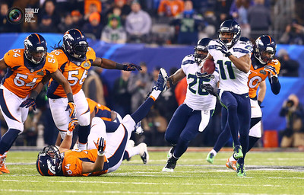
National Football League (NFL)
NFL is a professional American football league
32 teams compete in the NFL
Super Bowl is annual league championship game
Flickr: Molto Torres

Slide 4
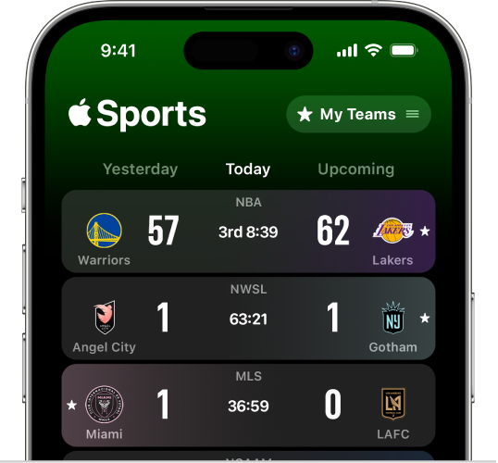
NFL Sports App
Objective: Obtain stats from the NFL games.
Targeted users: Football fans, statisticians.
Possible Applications
Fantasy Football
Sports Betting
Casual information
Source: https://support.apple.com/en-tm/guide/apple-sports-app/apdec6a74b4c/web

Slide 5
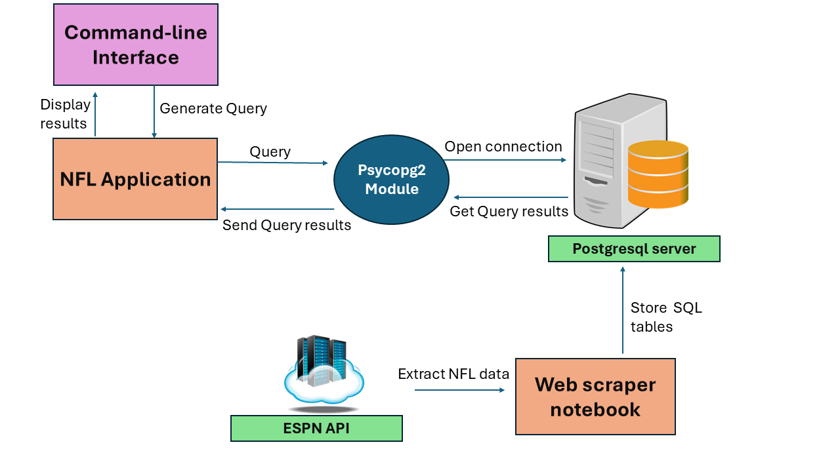
NFL database system implementation
Python application
Extract past 10 years of NFL data from ESPN API

Slide 6
NFL Application Installation
NFL application publicly available at GitHub
https://github.com/JamesChapmanNV/NFL_database
Read the documentation for installation

Slide 7
NFL Application Walkthrough
Demonstrate the NFL application

